Slide 1
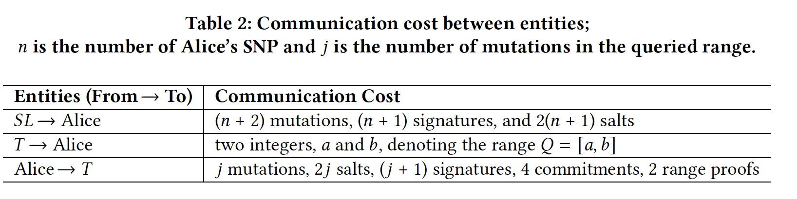
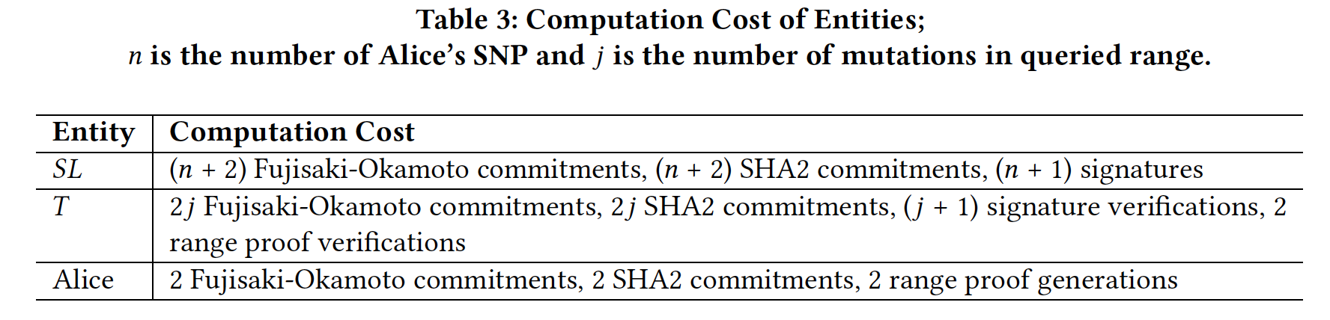
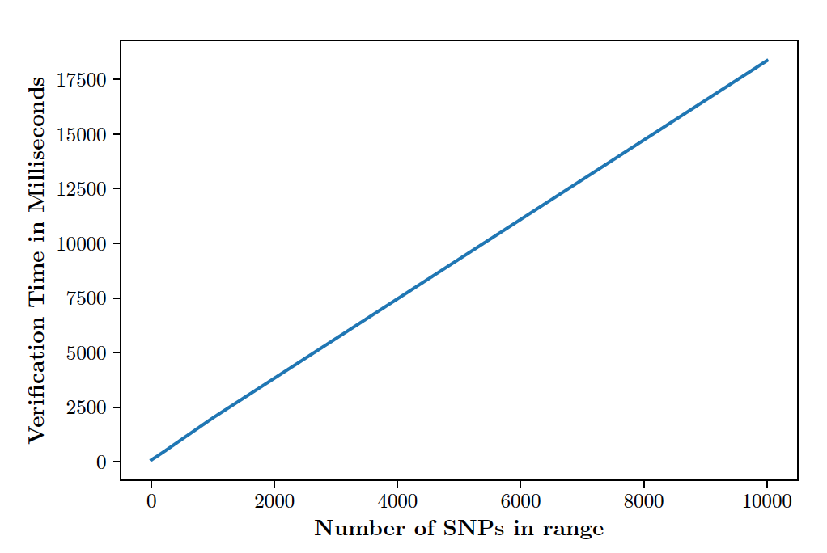
WPES’19 part (Section 4)
Each operations \ Runtime (ms) | Section 4 protocol (name?)
FO commitment
ZKP proof generation (RP)
ZKP proof validation (RP)
SHA2 commitment
Need to change Boudot’s RP runtime to BulletProof runtime
“Communication/Computation cost for each party”
RP \ Runtime (ms) | Section 4 protocol
Boudot’s RP
Sig-based [CCS’08]
BulletProof
We don’t need this, just cite the survey paper
Signature verification is the most expensive operation,
but it is linear to #(SNP)

Slide 2
Extension part
At least this part should be
(and will be) more efficient
 | Runtime (ms)
 | Offline Phase | Online Phase
SPH-PSM based GT [WPES’13]
Secure SPH-PSM based GT
Secure & Efficient SPH-PSM based GT
More Efficient Secure PSM based GT
“We can add security by adding this small time”
“We can improve efficiency by using SNP”
“By reducing range scope, we can improve efficiency even more”
Functionalities & Properties | Genomic representation |  | Security | Privacy
 | Whole DNA | SNP |  | Alice | Tester
SPH-PSM based GT [WPES’13] | ✓ |  | X | O | O
Secure SPH-PSM based GT | ✓ |  | O | O | O
Secure & Efficient SPH-PSM based GT |  | ✓ | O | O | O
More Efficient Secure PSM based GT |  | ✓ | O | O | △
AHE \ Runtime (ms) | enc | dec | Hom. operation
Paillier
AH ElGamal
How much it’ll take for each encryption,
So that we can estimate the whole runtime for genomes

Slide 3





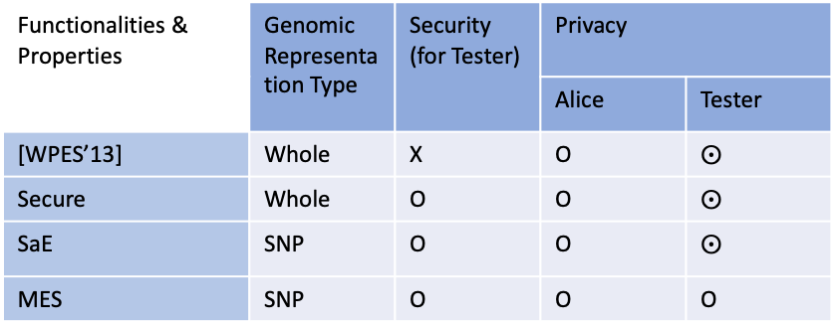






To explain this, we need to know what operations each protocol runs and the times required for each operation
 | AddHom Enc
 | ElGamal | Paillier
Enc
IsZero
MultCiphers
MultConstant
(Maybe one case with fixed n and m)
Time ($μ$s)
Fixed n = 100000
 | ElGamal | Paillier
wpes13
secure
sae
mes
4 stacked graphs for each protocol.
Performance varies depending on m, but most are for offline phase and user can choose one that fits for their environment
ElGamal is faster than Paillier, so we use (AH) ElGamal
$$10000$$
$$20000$$
$$⋯$$
$$100000$$
Time ($μ$s)
Fixed ratio n:m
m := Number(markers)
Functionalities & Properties | Genomic Representation Type | Security (for Tester) | Privacy
 |  |  | Alice | Tester
[WPES’13] | Whole | X | O | $⨀$
Secure | Whole | O | O | $⨀$
SaE | SNP | O | O | $⨀$
MES | SNP | O | O | O
One graph with four lines. In real case of n=3.2*10^9,
The ~~ protocol would be the most efficient one
+ For maximum privacy, more communication cost is inevitable
$${10}^{4}$$
$${10}^{5}$$
$${10}^{6}$$
$${10}^{7}$$
$${10}^{8}$$
n := Number(whole genes)

Slide 4
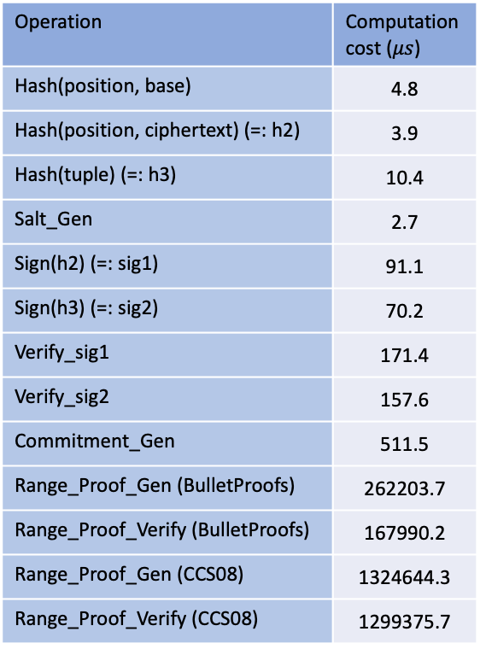
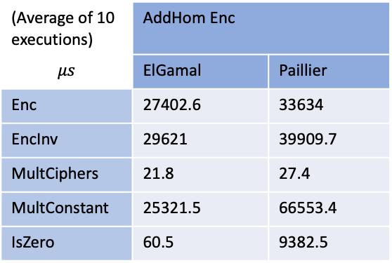
Running Time for each operation
(Using ElGamal)
(Average of 10 executions)
(Average of 10 executions) | AddHom Enc
$$μs$$ | ElGamal | Paillier
Enc | 27402.6 | 33634
EncInv | 29621 | 39909.7
MultCiphers | 21.8 | 27.4
MultConstant | 25321.5 | 66553.4
IsZero | 60.5 | 9382.5
Operation | Computation cost ($μs$)
Hash(position, base) | 4.8
Hash(position, ciphertext) (=: h2) | 3.9
Hash(tuple) (=: h3) | 10.4
Salt_Gen | 2.7
Sign(h2) (=: sig1) | 91.1
Sign(h3) (=: sig2) | 70.2
Verify_sig1 | 171.4
Verify_sig2 | 157.6
Commitment_Gen | 511.5
Range_Proof_Gen (BulletProofs) | 262203.7
Range_Proof_Verify (BulletProofs) | 167990.2
Range_Proof_Gen (CCS08) | 1324644.3
Range_Proof_Verify (CCS08) | 1299375.7
With a range (0,1.5*10^9) and a secret 1.0*10^9

Slide 5
Computation comparison
N: #(whole genes), n: #(Alice’s SNPs) ($≈0.1\%∗N$), m: #(markers), k: #(Alice’s SNPs in a queried range) (Note. m $≤$k $≤$ n)
wpes13 | Alice_Offline | N Enc
 | Tester_Offline | m EncInv
 | Tester_Online | 1 Enc, 2m multCiphers, 1 multConstant
 | Alice_Online | 1 isZero
secure | SL_Offline | N Enc, N Hash, N Sign
 | Tester_Offline | m EncInv
 | Tester_Online | m sig_Verify, 1 Enc, 2m multCiphers, 1 multConstant
 | Alice_Online | 1 isZero
sae | SL_Offline | n+2 Enc, n+2 Commitment, n+1 Hash, n+1 Sign
 | Alice_Offline | n+2 Commitment
 | Tester_Offline | m EncInv
 | Tester_Online | 2 boundary_check, 2 commitment_check, n+1 Hash, n+1 sig_Verify, n Enc, (n-m+1) multConstant (no_op) 2(n-m+1)*m multCiphers (op) (3n-m) multCiphers
 | Alice_Online | (average) n/2 isZero
mes | SL_Offline | n+2 Enc, n+2 Commitment, n+1 Hash, n+1 Sign
 | Alice_Offline | n+2 Commitment
 | Tester_Offline | m EncInv
 | Alice_Online1 | computeBoundaryIndex, 2 range_proof_gen
 | Tester_Online | 2 range_proof_verify, k+1 Hash, k+1 sig_Verify, k Enc, (k-m+1) multConstant (no_op) 2(k-m+1)*m multCiphers (op) (3k-m) multCipher
 | Alice_Online2 | (average) k/2 isZero

Slide 6
Communication comparison
N: #(whole genes), n: #(Alice’s SNPs) ($≈0.1\%∗N$), m: #(markers), k: #(Alice’s SNPs in a queried range) (Note. m $≤$k $≤$ n)
wpes13 | (Online) Alice -> Tester | n ciphertexts, 1 public key
 | (Online) Tester -> Alice | 1 ciphertext
secure | (Offline) SL -> Alice | n ciphertexts, n signatures
 | (Online) Alice -> Tester | n ciphertexts, n signatures, 1 public key
 | (Online) Tester -> Alice | 1 ciphertext
sae | (Offline) SL -> Alice | n+2 ciphertexts, n+2 salts, n+1 signatures
 | (Online) Alice -> Tester | n+2 ciphertexts, n+2 commitments, n+1 signatures, 2 positions, 2 salts
 | (Online) Tester -> Alice | n ciphertexts
mes | (Offline) SL -> Alice | n+2 ciphertexts, n+2 salts, n+1 signatures
 | (Online) Alice -> Tester | k+2 ciphertexts, k+2 commitments, k+1 signatures, 2 range proofs
 | (Online) Tester -> Alice | k ciphertexts
Notes:
5/17 comments:
add communication comparison table
(Ercan – takes the draft) Make draft to be readable form before summer
(draft) related work -> with context. Why we chose wpes13,…
Need to check if Bulletproof is the best RP…. Or is it server’s problems? (not sure but doubt it..)
Need better names, but for now, let’s have P1, P2, P3 and change it later
Table 3 – genome representation type (whole / snp) (to be one column), securirty ”for Tester”, and add caption for notation

Slide 7
To do list
Salts generated by one initial salt (e.g. HKDF)
Use the position/counter to generate it?
In Section 4 protocol, trade-off between bandwidth and computation cost
SL’s sending all COMs : bandwidth ↑, Alice’s computation cost ↓
Otherwise, Alice needs to recompute all COMs: bandwidth ↓, Alice’s computation cost ↑
Need to check the sizes and runtimes of each commitment schemes
Check the ecdsa signature sizes -> 64 bytes (512 bits)
Organize and implement AHE functions (e.g. modinv, add, mult, …?)
EncryptInverse, MultCipherts, HideCipherWithR (for both AHElGamal and GGGP)
Check security parameters for the same degree(?) of security
Need random permutation
Randomize once would be okay (2013 paper was doing randomization once,, sorry. Need to fix figures in the draft)
SL’s SequenceWhole() and SequenceSNP() (Figure 5 and Figure 7)
Tester’s Figure 6, Figure 8, Figure 9
Reproduce 2013 paper
Make each protocol and test codes
Issues:
Figure 7, SL gives the Position array to Alice, so that Alice doesn’t need to decrypt everything (Need to fix the figure)
Figure 8, to hide the size of marker, Tester should add m bogus (non-zero) results, shuffle, and send the res list (Need to add this to figure)
Ah… in Figure 9, two j’s are used in different ways. Need to fix the figure! One for the size of mutations in the range, i.e., M_Q = {m_k+1, …, m_k+j} and the other for the nested loop index

Slide 8
Toy result with small number of genes
Settings | Alice: ‘T’ in [100, 300] and ‘A’ in the others, total #(genes) = 1000 For SNP, regular gap = 10 (for both Alice and Tester) | Expected result
Test1 (Exact matching) | Tester’s marker (including all ‘T’) is in [100, 300] | true
Test2 (Partial matching) | Tester’s marker is in [50, 150] | false
Test3 (Partial matching2) | Tester’s marker is in [250, 350] | false
Test4 (No matching) | Tester’s marker is in [1, 99] (note. 0-th element is for sentinel? base) | false
Test5 (No matching2) | Tester’s marker is in [301, 400] | false
Note. For ”More Efficient and Secure PSM based GT”, queried range is [marker’s startingPosition – secParam, marker’s endPosition + secParam] with secParam = 50
Runtime (s) | Test1 |  | Test2 |  | Test3 |  | Test4 |  | Test5
 | ElGamal | Paillier | ElGamal | Paillier | ElGamal | Paillier | ElGamal | Paillier | ElGamal | Paillier
WPES13_reproduce | 2.39 | N/A | 2.23 | N/A | 2.26 | N/A | 2.54 | N/A | 2.44 | N/A
Secure SPH-PSM based GT | 2.21 | 3.33 | 2.04 | 3.16 | 2.05 | 3.33 | 2.29 | 3.52 | 2.08 | 3.27
Secure and Efficient SPH-PSM based GT | 0.65 | 1.18 | 0.61 | 1.07 | 0.62 | 1.04 | 0.63 | 1.02 | 0.63 | 1.06
More Efficient and Secure PSM based GT | 0.94 | 1.23 | 0.93 | 1.13 | 0.97 | 1.24 | 0.90 | 1.10 | 1.08 | 1.13

